Slide 1
Week 5 Recitation
Exam 1
Chapter 2 eq: 47-49
Chapter 3 eq: 93-95
Chapter 4 eq: 143-146

Slide 2
Questions?

Slide 3
Midterm Information
The exam will be held from 7-8:50 pm on Friday 10/2; an extra 10 minutes will be provided to format and upload responses.
9/30 (Wed.) is the cut-off date for material covered on the exam.
Students will upload a single PDF document.
We will be accepting written or electronic submissions.
Full credit will require showing work, specifying units, and reporting to the correct number of significant figures.
The exam is “open book,” but do not seek assistance from others.
Follow the Code of Conduct, we will be required to refer suspected cases to the Council of Academic Misconduct.

Slide 4
Logistics
Issues converting notebooks, has to do with symbols?
Check the posted answer key to compare – will try to submit grades by tomorrow evening!
Might use Doodle polls more in the future

Slide 5
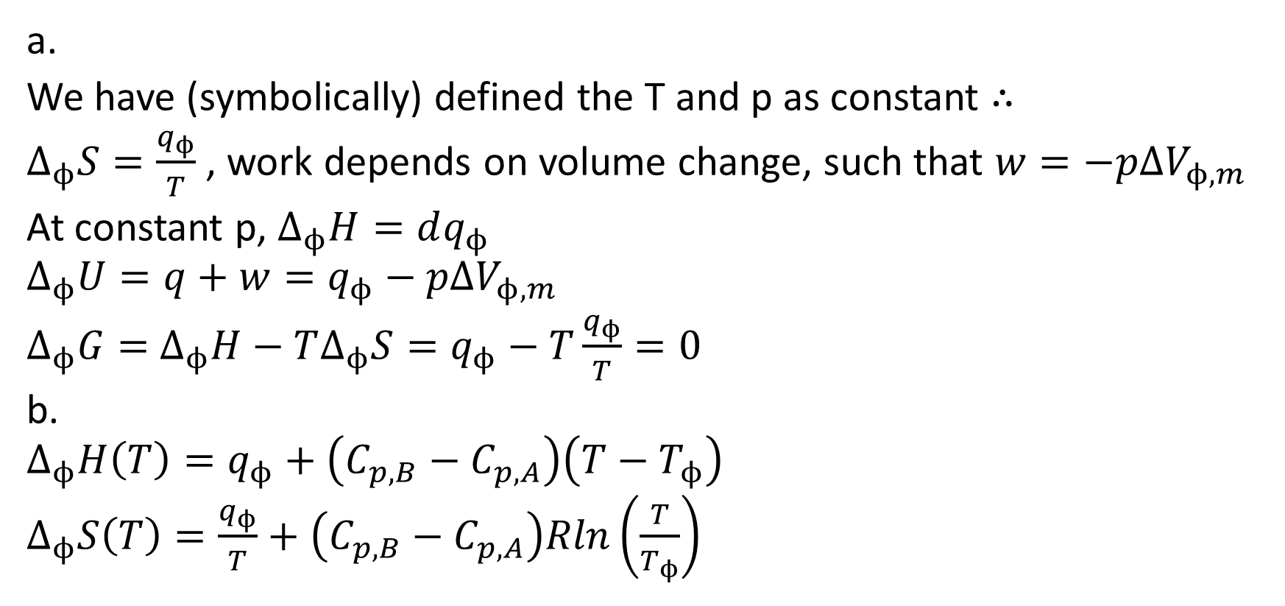
HW3 Revision: 3.18a and b
a.
We have (symbolically) defined the T and p as constant $∴$
$Δ_{ϕ}S=\frac{q_{ϕ}}{T}$ , work depends on volume change, such that $w=−pΔV_{ϕ,m}$
At constant p, $Δ_{ϕ}H=dq_{ϕ}$
$$Δ_{ϕ}U=q+w=q_{ϕ}−pΔV_{ϕ,m}$$
$Δ_{ϕ}G=$ $Δ_{ϕ}H−TΔ_{ϕ}S=q_{ϕ}−T\frac{q_{ϕ}}{T}=0$
b.
$$Δ_{ϕ}H\left(T\right)=q_{ϕ}+\left(C_{p,B}−C_{p,A}\right)\left(T−T_{ϕ}\right)$$
$Δ_{ϕ}S\left(T\right)=\frac{q_{ϕ}}{T}+\left(C_{p,B}−C_{p,A}\right)Rln\left(\frac{T}{T_{ϕ}}\right)$

Slide 6
HW3 Revision: 3.18d and e
d.
To calculate the dH/dS/dG at a new temperature, use the following:
dH(T2) = dH(T1) + dCp*(T2-T1)
dS(T2) = dS(T1) + dCp*ln(T2/T1)
dG(T2) = dH(T2) – T2dS(T2)
e.
High p favors the side with smaller molar V, phase B sees an increase of +3 mL/mol, thus melting T will increase and phase A will be favored.

Slide 7
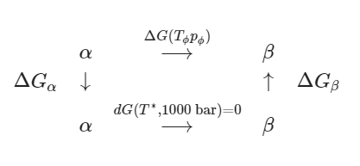
HW3 Revision: 3.18f
dGa + dGb = 0 = dV(p-1000)-dS(T)-dCpln(Tm/T*)
dV = Vb-Va
dCp = Cpb-Cpa

Slide 8
HW3 Revision: 3.30
A closed container is at 1 bar/273 K is placed in a -20 deg C freezer. What is the maximum pressure developed at equilibrium? dH = 333.4 kJ/kg, rho = 0.9172 (ice) and 1.00 g/mL (water)
Consider the starting conditions:
dG273K = 0, dG253K = ?
We have an enthalpy of fusion and known temp., use Gibbs-Helmholtz:
dG253K = 253*(dG273K/273 + (1/253 – 1/273)*333.4*10)
dG253K = -244 bar*mL/g
Use dG253K in the next part…

Slide 9
HW3 Revision: 3.30 cont.
For the second step, recognize that the maximum pressure = constant, T is also defined, so the dG at the end of this process is equal to 0:
dG253K(p2) = 0
dV = (1.00-0.9172)/(1.00*0.9172), units in mL/g
dp = (dG253K(p2) - dG253K)/dV
Add initial pressure (1 bar) with dp to get the maximum pressure:
2705 bar, 2.7e3 bar

Slide 10
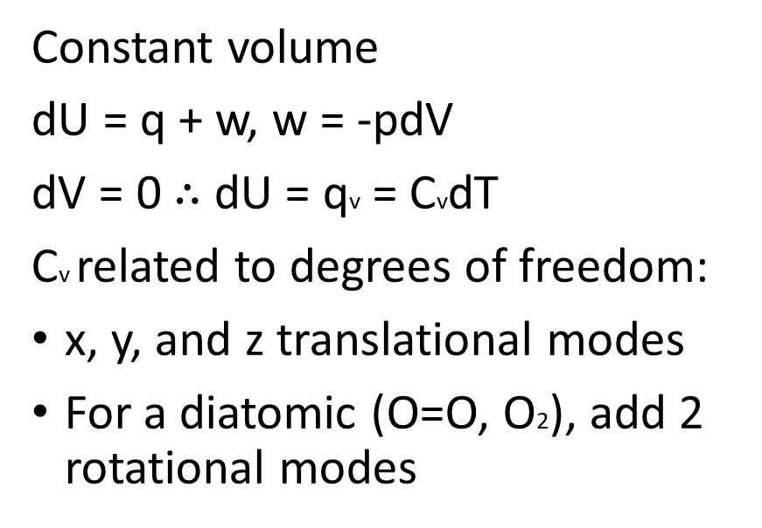
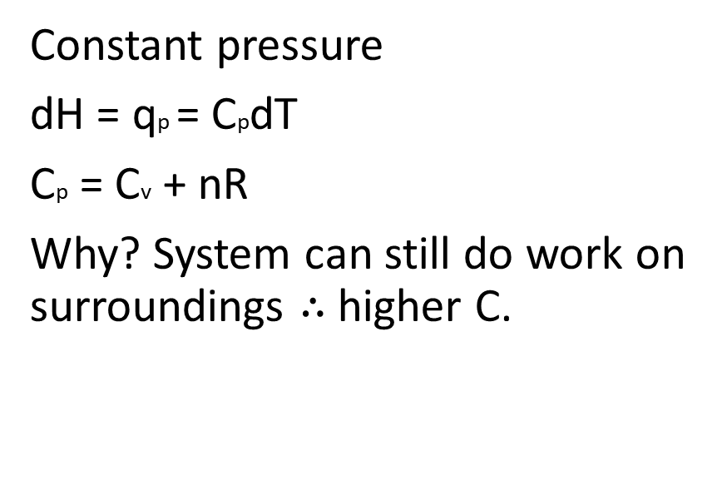
Ch 2 Review: Definitions of C, H, and U
Understand the First Law and its implications
System, surroundings, work (w) done on(+)/by(-), heat flow (q)
Constant pressure
dH = qp = CpdT
Cp = Cv + nR
Why? System can still do work on surroundings $∴$ higher C.
Constant volume
dU = q + w, w = -pdV
dV = 0 $∴$ dU = qv = CvdT
Cv related to degrees of freedom:
x, y, and z translational modes
For a diatomic (O=O, O2), add 2 rotational modes

Slide 11
Ch 2 Review: State vs Path Variables
State variables only depend on the current state of the system:
p, pressure
V, volume
T, temperature
If a variable is a function of state variable, then it is also a description of state:
U = 3/2nRT
H
Path variables change depending on how the system proceeds:
w, reversible or irreversible
w = -pdV
w = -nRTln(V2/V1)
q, reversible or irreversible
Notes:
Not including content on temperature dependence or calculating heat transfer, phase change, etc., as that is getting a bit too basic to be helpful.

Slide 12
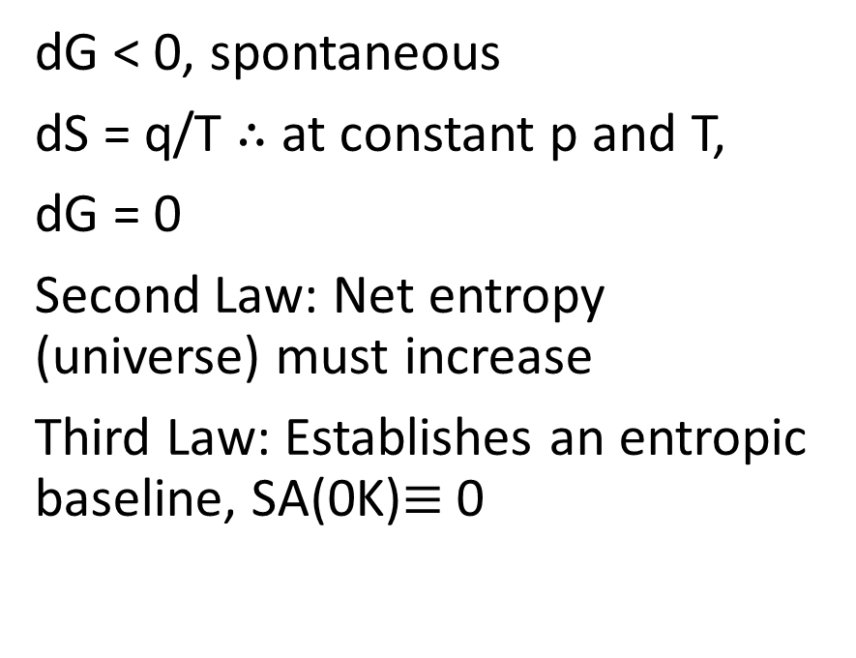
Ch 3 Review: Definition of S and Carnot
Understand the Second Law and its implications
Spontaneity of reaction, entropy, free energy, Third Law
dG < 0, spontaneous
dS = q/T $∴$ at constant p and T,
dG = 0
Second Law: Net entropy (universe) must increase
Third Law: Establishes an entropic baseline, SA(0K)$≡$ 0
1. Isothermal expansion
q1 = -w1 = nRThotln(V2/V1)
2. Adiabatic expansion, q2 = 0
dU = nRln(V2/V3)
3. Isothermal compression
q3 = -w3 = nRTcoldln(V4/V3)
4. Adiabatic compression, q4 = 0
dU = nRln(V4/V1)
Notes:
q2 and q4 = 0, so only steps 1 and 3 allow one to calculate heat flow
Total work can be determined by summing each calculated, steps 2 and 4 cancel, such that dU = 0 but there is still work done and heat expended.

Slide 13
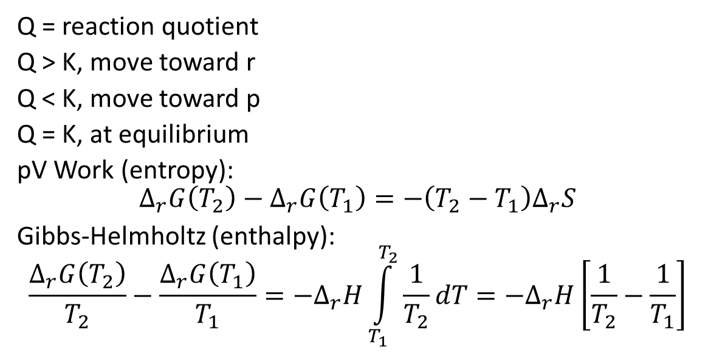
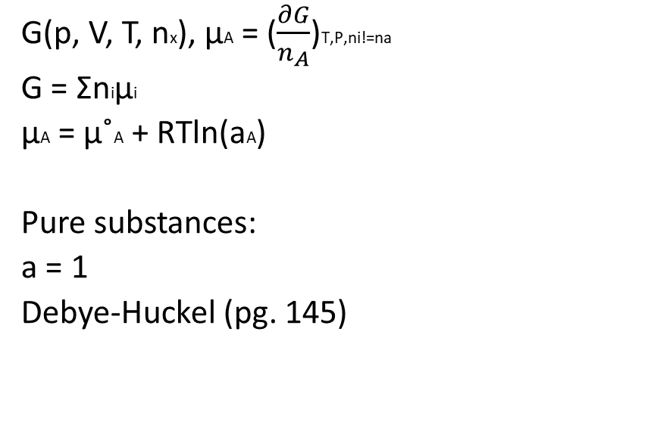
Ch 4 Review: G, Chemical Potential, K, and a
Understand the connections between G, K, and mu
Understand how activities (a) affects G and K
G(p, V, T, nx), μA = ($\frac{∂G}{n_{A}}$)T,P,ni!=na
G = Σniμi
μA = μ˚A + RTln(aA)
Pure substances:
a = 1
Debye-Huckel (pg. 145)
Q = reaction quotient
Q > K, move toward r
Q < K, move toward p
Q = K, at equilibrium
pV Work (entropy):
$$Δ_{r}G\left(T_{2}\right)−Δ_{r}G\left(T_{1}\right)=−\left(T_{2}−T_{1}\right)Δ_{r}S$$
Gibbs-Helmholtz (enthalpy):
$$\frac{Δ_{r}G\left(T_{2}\right)}{T_{2}}−\frac{Δ_{r}G\left(T_{1}\right)}{T_{1}}=−Δ_{r}H\int_{T_{1}}^{T_{2}}{\frac{1}{T_{2}}dT}={−Δ}_{r}H\left[\frac{1}{T_{2}}−\frac{1}{T_{1}}\right]$$

Slide 14
Questions?

